Slide 1
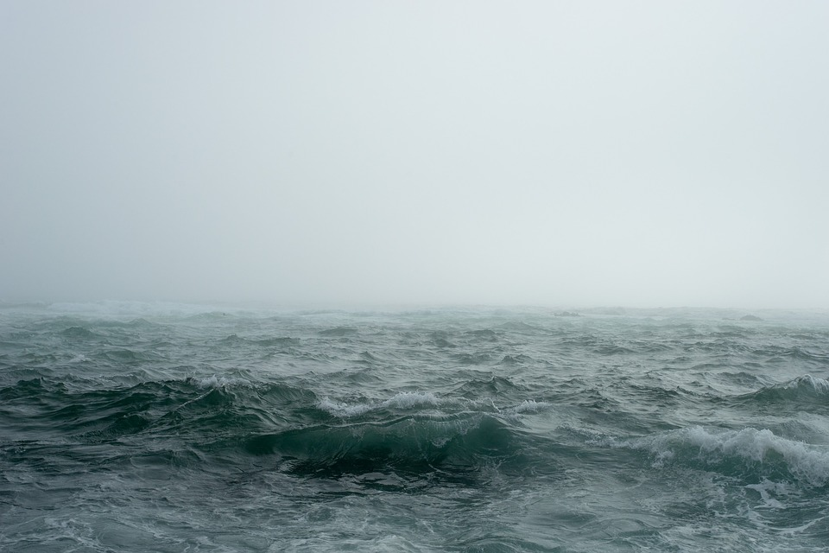
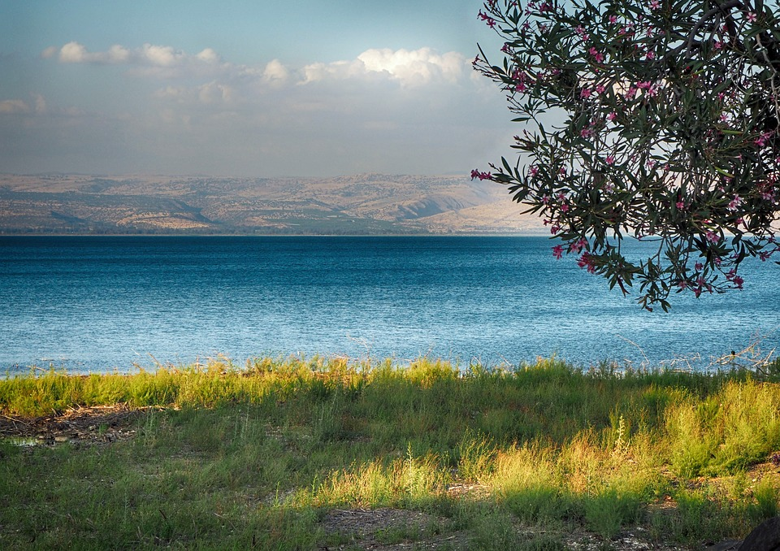
So the men marveled, saying, "Who can this be, that even the winds and the sea obey Him?"
Matthew 8:27 NKJV

Slide 2
Finding the way of escape

Slide 3
And do not lead us into temptation, but deliver us from the evil one. Matthew 6:13 NKJV
* Js. 1:13
* Strengthens humility Mt. 5:3
* Expression of trust Mt. 7:7
* Reminds us of reality Eph. 6:12
Finding the way of escape
Notes:
II. Pray, as Jesus taught Mat. 6:13
A. Js. 1:13 God will not tempt us to sin, but in order to strengthen us, God will lead us to a place where He knows Satan will tempt us---pray for God’s help before, during, and after.
B. This request strengthens humility, essential in the kingdom (Mt. 5:3)
1. a constant reminder/admission of weakness without God’s help
2. We truly are outmatched by Satan without God’s help—he has “devoured” saints stronger than us.
C. Expression of trust Mt. 7:7
1. This is an admission that though I plan to go… and do…, God is leading, and I will follow.
D. Reminds us of the reality of spiritual danger
1. Eph. 6:12 we cannot see everyone involved in the battle we participate in
2. Our society ignores or minimizes this part of reality, requiring us to stay watchful and sober
a. some entertainment in the past included prayer, church in varying degrees
b. The church of England apologized for stating that sex is only for heterosexual, married couples--what do they think about the sermon on the mount? CITATION
c. Even some Christians are queasy about identifying modern rel. error specifically and publicly, preferring everything public be positive, not condemning (sermon on the mount, Mt. 5:20; 6:7).

Slide 4
Be sober, be vigilant; because your adversary the devil walks about like a roaring lion, seeking whom he may devour. Resist him, steadfast in the faith, . . . 1 Peter 5:8-9 NKJV
* lit. to abstain from wine; fig…self-control” 1 Pe. 1:13
* “watch” Mt. 26:40-41
* To recognize the enemy and temptation
Finding the way of escape
Notes:
I. Sober, vigilant… resist him 1 Pet. 5:8-9
A. Word
1. sober- “lit. to abstain from wine; fig. sober, self-control” (Strong, Thayer); 1:13 gird up…, be sober
2. vigilant- watch, Mt. 26:40-41
3. = “awake, alert”
B. To recognize the enemy, temptation, sin
1. external attack- who is pleased by the teaching I hear, my daily decisions?
a. In Gen. 3, Satan was subtle, there was a degree of truth to his words (eyes opened)
b. “We should celebrate Jesus’ birth and resurrection” to justify holy days Xmas, Easter (=/+ to LD)
2. internally
a. is my thinking, desire, plans worthy of my calling?
b. are my words gossip or am I seeking advice? both may involve talking about others, but I must discern
3. To recognize and follow the way of escape (1 Cor. 10:13)
a. God is faithful, giving me opportunities to add self-control to my faith--essential to the way of escape
b. Its impossible to see the way of escape with my eyes on hatred, contentions, jealousies, outbursts of wrath, or selfish ambitions.
C. What sin has the strongest appeal to you? By growing in sobriety, watching God helps you find the way…

Slide 5
Let no one say when he is tempted, "I am tempted by God"; for God cannot be tempted by evil, nor does He Himself tempt anyone. But each one is tempted when he is drawn away by his own desires and enticed. Then, when desire has conceived, it gives birth to sin; and sin, when it is full-grown, brings forth death. James 1:13-15 NKJV
To avoid sin, to what do I need to pay attention?
Finding the way of escape
Notes:
III. Aware of desires Js. 1:13-15 (flee and pursue/draw near to God)
A. Notice the progression: desires of varying strengths -- drawn away (dragged) -- enticed (caught by bait--his desires) -- desire has conceived (lit, conception is the combination of sperm and egg, here the combination of my desire and my will = I inwardly receive the sinful desire) -- unstopped desire grows in us into a decision giving birth to sin -- sin gives birth to death.
* At what point do I need to focus to avoid this process reaching sin, death? the beginning--desires
B. Which desires most easily or commonly lead me to action?
1. Do I eat every time I’m hungry? Does my world stop every time I’m hungry or do other desires delay action?
2. As a general rule, do I strongly desire to tell or show other people what I think ASAP? Do I consistently act on that desire or do other desires (like, producing the righteousness of God) slow/delay my speech?
C. Seeing and taking the way of escape involves an awareness of my particularly strong desires (good, bad, neutral)

Slide 6
But He gives more grace. Therefore He says: "God resists the proud, but gives grace to the humble." Therefore submit to God. Resist the devil and he will flee from you. Draw near to God and He will draw near to you. Cleanse your hands, you sinners; and purify your hearts, you double-minded. Lament and mourn and weep! Let your laughter be turned to mourning and your joy to gloom. Humble yourselves in the sight of the Lord, and He will lift you up. James 4:6-10 NKJV
* my presence Ps. 1:1
* my eyes Job 31:1
* my thoughts Pro. 4:20-23
Finding the way of escape
Notes:
IV. Flee, resist and submit to, draw near 2 Tim. 2:22; Js. 4:6-10 not chase enticements but draw near with--
A. my presence Ps. 1:1
1. ever been somewhere knowing “I don’t belong here. . .”? I have and shudder to think “what if I stayed?”
2. when lewd dancing is the purpose of a gathering (PROM)--can I draw near to God there, doing that?
3. Anywhere with Jesus I can safely go…--always stay in places wherein I can draw near to God
B. my eyes Job 31:1 (Prov. 23:31-32; Heb. 11:26)
1. guarding your eyes is a major part of avoiding many temptations [Eve failed]
2. when something attractive is visible, it is hard to look away and to something invisible..have you learned?
C. my thoughts Prov. 4:20-23 (Mt. 5:28)
1. Here is where desires die, decline, increase, or are conceived.
2. Everything I see/hear contributes to my thoughts which contribute to my desires.
a. does what I choose to hear/see require me to resist/flee or aid me in submitting/drawing near?
b. what about my children, whose thinking and convictions are developing?
3. What kind of guard, filter have you set at the door to your heart, thoughts (esp eyes and ears)?
D. Even when I love God enough to guard my eyes, presence, and thoughts I will still face temptations, but I will also be fully armed, prepared to face it.

Slide 7
Father, if it is Your will, take this cup away from Me; nevertheless not My will, but Yours, be done.
Luke 22:42 NKJV
* Jesus faced temptations
* Express thanks 1 Th. 5:18
* God is faithful
Finding the way of escape
Notes:
V. Accept God’s help
1. Jesus prayed not to be led to this trial, yet faced untold temptations Lk. 22:42
a. He also prayed not My will, but Yours, be done
b. What were the temptations as He drank the cup?
c. He was delivered from all trials of that night and day after a few hours
2. When God leads us to face some temptation or trial, learn from Job 42:1-3
a. God can do all things (but Satan cannot)
b. We cannot know all of God’s purpose(s), but we don’t have to know all when we trust and obey.
3. When God leads us from some temptation or trial, He deserves our thanks 2 Pet. 2:9
a. this will aid us “next time”
4. Remember that God is always willing to deliver us from evil
a. led some into gardens or wildernesses, for which they were prepared and kept them from others.
b. offered His help before, during, and after every trial and temptation
c. He knows what is good for us—His weak, learning, dependent little children

Slide 8
Finding the way of escape
Turn to Christ Acts 2:38; Rom. 10:10
Return to Christ Acts 8:22; 1 Jn. 1:9
Abide in Christ John 15:7

