Slide 1
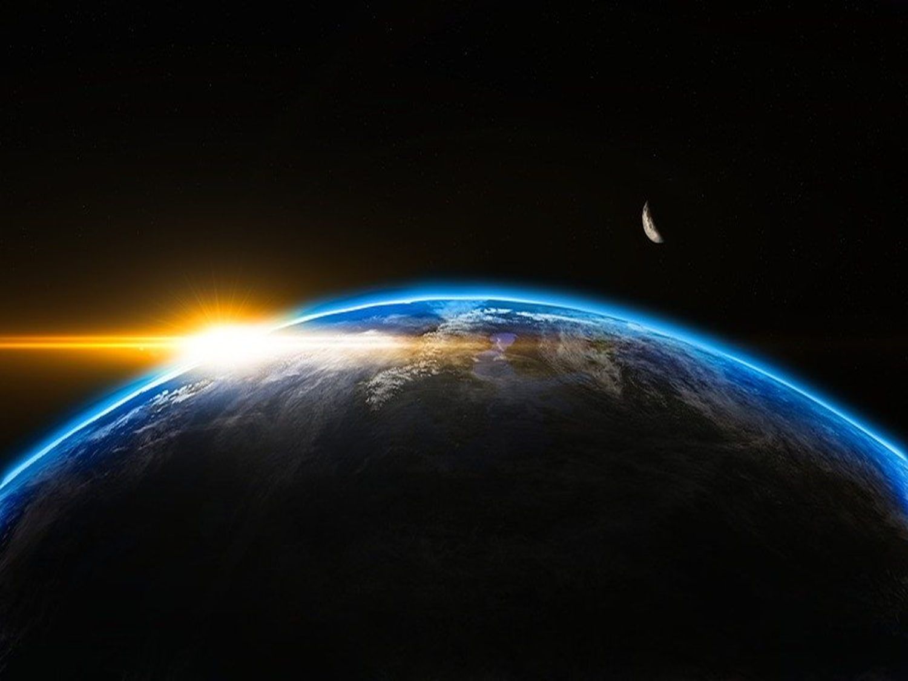
When I consider Your heavens, the work of Your fingers, the moon and the stars, which You have ordained, what is man that You are mindful of him, and the son of man that You visit him? (Psalms 8:3-4 NKJV)

Slide 2
There is a God
What difference does it make in you?

Slide 3
What difference does it make to you?
In some areas, there is no difference
All have sinned Rom. 3:23
All made in God’s image Gen. 1:27; Js. 3:9
All will die and be judged Heb. 9:27
All are known by God Ps. 139:1-16

Slide 4
What difference does it make to you?
On your view of God, self, others
Do you think higher of yourself? Rom. 2:17-24; Lk. 18:9-12
Do you think higher of God? Lk. 18:13-14
Do you think of the needs of others?

Slide 5
What difference does it make to you?
On your desire to learn more
Rom. 11:33-34
Who God is (Gen. 1-3)
What God does Gen. 1:1; Matt. 18:23-27
What God says Ps. 119:129-136

Slide 6
What difference does it make to you?
On what you choose
1 Jn. 5:3; 2 Pet. 1:2-10
- for your benefit
- for others’ benefit

Slide 7
There is a God
What difference does it make in you?
There is a Savior
Turn to Him Acts 2:38; Rom. 10:10
Return to Him Acts 8:22; 1 Jn. 1:9
Abide in Him John 15:7

