Slide 1
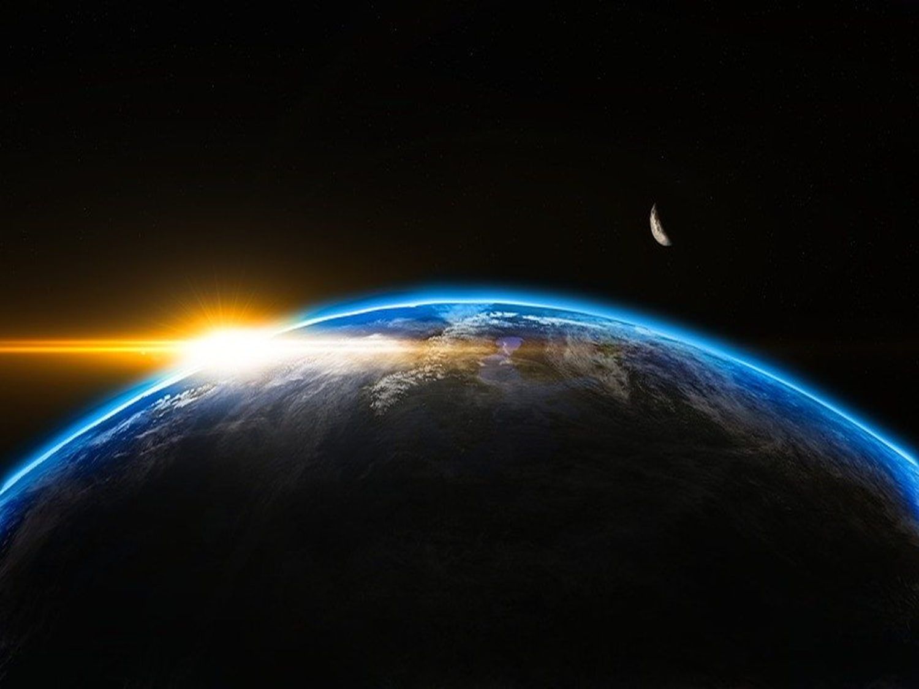
When I consider Your heavens, the work of Your fingers, the moon and the stars, which You have ordained, what is man that You are mindful of him, and the son of man that You visit him? (Psalms 8:3-4 NKJV)

Slide 2
There is a God

Slide 3
There is a God
Who is unseen Jn. 1:18; 6:46; 1:14; 20:29-31
Are all unseen things unbelievable?
Beginning of the univ.
Life of your ancestors
Logic, reason
Existence of the univ.
Your life
Its use and success

Slide 4
There is a God
Who has revealed His power and deity Rom. 1:20

Slide 5
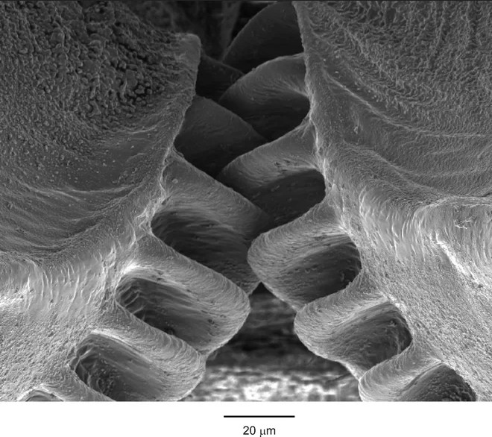
Gears of the insect “planthopper” nymph
“We usually think of gears as something that we see in human designed machinery, but we’ve found that that is only because we didn’t look hard enough,” Sutton said. “These gears are not designed; they are evolved—representing high speed and precision machinery evolved for synchronisation in the animal world.”
www.smithsonianmag.com
“Genetics might be adequate for explaining microevolution, but microevolutionary changes in gene frequency were not seen as able to turn a reptile into a mammal or to convert a fish into an amphibian. . . . The origin of species – Darwin’s problem – remains unsolved” (Gilbert et al., 1996). [Drs. Scott Gilbert, John Opitz and Rudolf Raff in the journal Developmental Biology]
O Timothy! Guard what was committed to your trust, avoiding the profane and idle babblings and contradictions of what is falsely called knowledge– by professing it some have strayed concerning the faith. Grace be with you. Amen.
(1 Timothy 6:20-21 NKJV)
Notes:
www.smithsonianmag.com/science-nature/this-insect-has-the-only-mechanical-gears-ever-found-in-nature-6480908/
Scott F. Gilbert, John M. Opitz, and Rudolf A. Raff, “Resynthesizing Evolutionary and Developmental Biology,” Developmental Biology 173 (1996): 357-372.

Slide 6
There is a God
Who has revealed His power and deity Rom. 1:20
Power
Deity
Earning trust Ps. 8:3-4; Mt. 6:25-34; 7:7-11

Slide 7
There is a God
Who has spoken Heb. 1:1-2
by the prophets Acts 3:21; 2 Pet. 1:19-21
by His Son Jn. 7:46

Slide 8
There is a Savior
Turn to Him Acts 2:38; Rom. 10:10
Return to Him Acts 8:22; 1 Jn. 1:9
Abide in Him John 15:7
What difference does it make to you? 5:30PM

