Slide 1
There are many who say, "Who will show us any good?" LORD, lift up the light of Your countenance upon us. Ps. 4:6 NKJV

Slide 2
When the world panics, Christians. . .

Slide 3
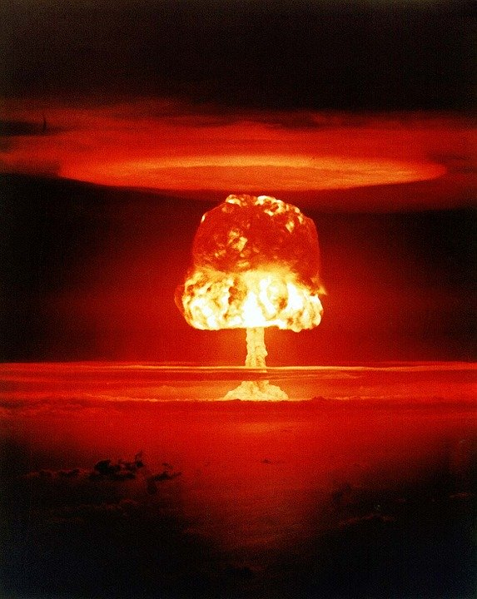
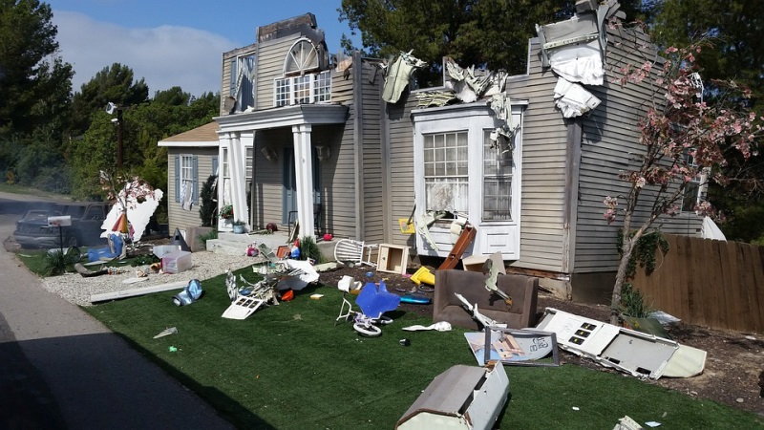
When the world panics, Christians. . .
Know God sees all Prov. 15:3
1. consider all God has seen Job 42:2
2. not all people have this assurance Ps. 4:6; Col. 4:5-6
Notes:
I. Know God sees all Prov. 15:3
A. Consider what God has seen in human history
1. Physical tragedies, from personal to world-wide
2. Physical success and breakthroughs
3. Rise and fall of nations
4. Birth and death of every individual Ecc. 12:7
5. What did all of those events accomplish?
a. Job 42:2 we cannot know…but we can know His purposes are not defeated
b. this is part of the peace that passes… (Phil. 4:6)
B. not everyone has this assurance Ps. 4:6a
1. if there is no God then life is no more or less valuable than death, so why worry about a virus that eradicates all human life?
2. if there are many gods with limited knowledge and abilities, they offer no certainty
3. Col. 4:5-6 without the knowledge and fear of the Lord, even the threat of some problem can be significantly unsettling, and we need to consider that with others--both sensitive and aware of opportunities.

Slide 4
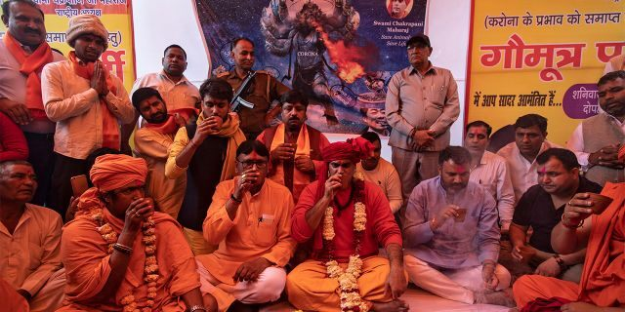
When the world panics, Christians. . .
Have a guide for conduct
1. the gospel of Christ Mk. 16:15; Rom. 1:16-17; Matt. 5-7
2. not everyone has this assurance or help
REUTERS/Danish Siddiqui
Notes:
II. Have a guide for conduct
A. in panic, people often forget or disregard “social norms,” leaving them with no guide
B. the gospel of Christ applies in all cultures and circumstances Mk. 16:15; Rom. 1:16-17
1. inward, outward Matt. 5-7 pure in heart, meek, anger, lust, adultery, love enemy, faith > fear, obey
2. unchanging Mt. 28:20 to the end of the age so doctrine of Christ is never outdated
3. practical Matt. 5-7 think, say, do, friend, spouse, enemy, money, two ways, false teachers, eternity
4. in disease, disaster, prosperity at world-wide, national, personal level all of the above is useful
C. Not everyone has this assurance or help
1. rely on cultural expectations
a. which change per perception and situation, ex., “martial law” changes expectations
b. cow urine (“gaumutra”) claimed to be medicinal…why cow? Hindu religion- false religion offers false hope
c. life on hold until a professional solves the problem and no other source for help
2. without God, no universal standards or priorities so seeking to spread, slow, or stop any disease is neither right or wrong.
3. As we choose who we will serve, remember that what we believe directs what we do Pr. 1:7; 9:10

Slide 5
When the world panics, Christians. . .
Keep an interest in others
1. God shapes our view Gen. 1:26; Rom. 13:9; Gal. 6:10; Mt. 7:12; Acts 4:34-35
2. Applies is all circumstances
disease
economic crash
natural disaster
civil unrest or war
tragedy
Notes:
III. Keep an interest in others
A. In panic, people often forget others
1. Survival becomes the ultimate goal with plenty of competition
2. Many have no one to rely on, trust, seek help from (maybe even moreso in Fairbanks)
3. Assume the gov’t will take care of things and think of no personal responsibility
B. God shapes our view of others
1. All people made in God’s image Gen. 1:26-27; Js. 3:9
2. Love neighbor as self Rom. 13:9
3. Do good unto all men Gal. 6:10
4. Whatever you want men to do to you… Mt. 7:12
5. With special attn. on the saints Acts 4:34-35 (Gal. 6:10; 1 Tim. 5:9-10)
a. the churches are only instructed to care for the phy needs (vs wants) saints (vs unbelievers)
b. the saints are instructed to care for all men
C. Our view of others applies in all circumstances (apply B. 1-3)
1. Disease (personal, widespread)
2. Natural disaster
3. Tragedy (personal, widespread)
4. Economic crashes
5. Civil uncertainty or war
6. Among the blessings of being a Xian is that you are among family--ppl who view you in the same way.

Slide 6
When the world panics, Christians. . .
Are content Prov. 1:7; 9:10
1. with what we can know, do Pr. 14:15; 25:19; Phil. 2:14-15
2. with what we cannot know, do Ps. 146:1-4; 2 Chron. 16:12; Mt. 6:34; Phil. 4:6-7
Notes:
IV. Are content
A. with what you can know and do
1. right, wise, can change…how do I know or know what to do?
2. Prov. 1:7; 9:10 with the fear of the Lord, when others panic (over virus or other cause)
a. we will not seek a loophole from the law of Christ (steal or lie to feel more secure)
b. we will welcome the wisdom of God
i. in OT, leprosy justified “quarantine” but not all illnesses (Lev. 13)
ii. get information from reliable, trustworthy sources (Pr. 14:15; 25:19)
c. my attitude toward problems, frustrations (Phil. 2:14-15…written from prison due to false charges)
B. with what you cannot know or do
1. human limitations (id or solve problems, how others act or react)
2. Prov. 1:7 with the fear of the Lord, when others panic (for any reason)
a. Ps. 146:1-4 remember God has appointed princes but they are limited
b. 2 Chr. 16:12 seeking physicians without God is like eating food without acknowledging God
c. Mt. 6:34; Phil. 4:6-7 consider the present and future with faith/trust > fear, worry

Slide 7
When the world panics, Christians. . .
Are you infected with sin?
Turn to Christ Acts 2:38; Rom. 10:10
Return to Christ Acts 8:22; 1 Jn. 1:9
Abide in Christ John 15:7

